Slide 1
Shell Bootcamp 2024 3 Reflections for Week 1
Anant Bhartiya
Date : 30-Aug-2024

Slide 2
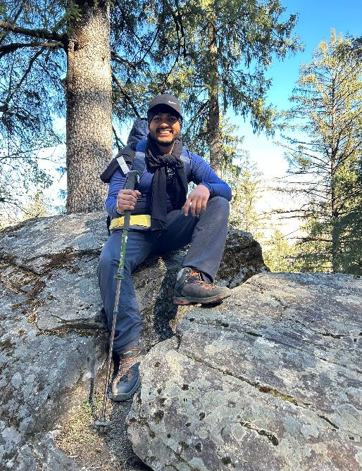
About Me
Exploring the world, embracing new challenges – my journey never stops

Slide 3

My learnings from this week!

Slide 4
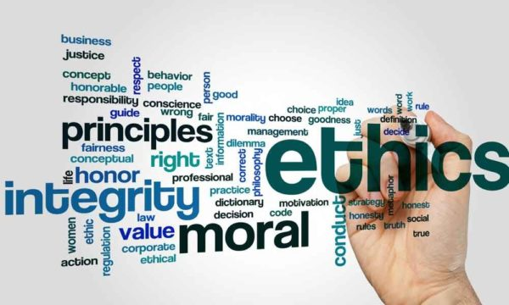
Learning 1 | My takeaways
Soft Skills Session: Professionalism, Grooming and Etiquette
Key learning: Recognized the power of effective communication and acknowledged the value of maintaining a professional attitude
Key takeaway: Professional email writing is vital for clear communication and preventing misunderstandings
In the energy sector, professionalism and clear communication are vital for fostering collaboration, safety and trust across global teams and operations.

Slide 5
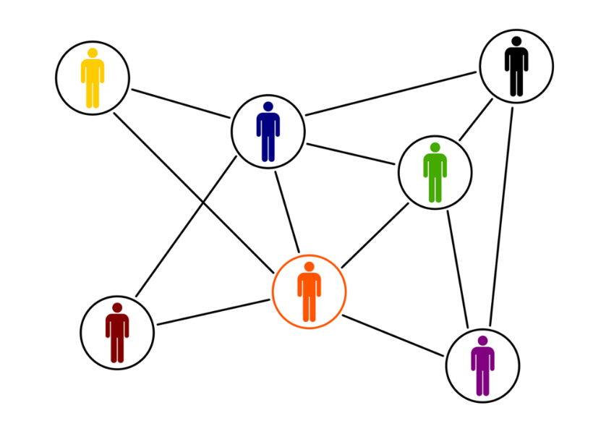
Learning 2 | My takeaways
Stakeholder management and Teamwork
Key learning: Identified stakeholders using the Power Interest Grid and emphasized that teamwork requires collaborating with other teams as well.
Key takeaway: Stakeholders are crucial in professional settings and, teamwork demands synchronization, dedication and focus
In the energy sector collaboration and meeting sustainability goals are key expectations from stakeholders.

Slide 6
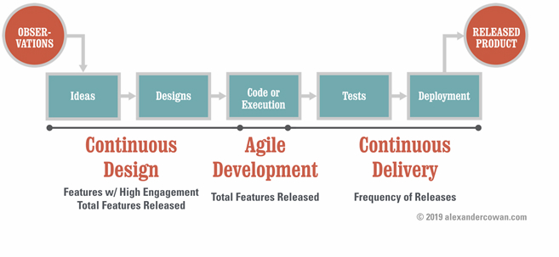
Learning 3 | My takeaways
Agile and Business Analytics
Key learning: Agile promotes adaptability while Business Analytics supports data-driven decisions.
Key takeaway: Agile enhances collaboration and analytics provide insights for better decisions.
In the energy sector agile helps teams adapt to change, while analytics optimize operations and sustainability.

Slide 7

Relevance of learnings for my organization

Slide 8
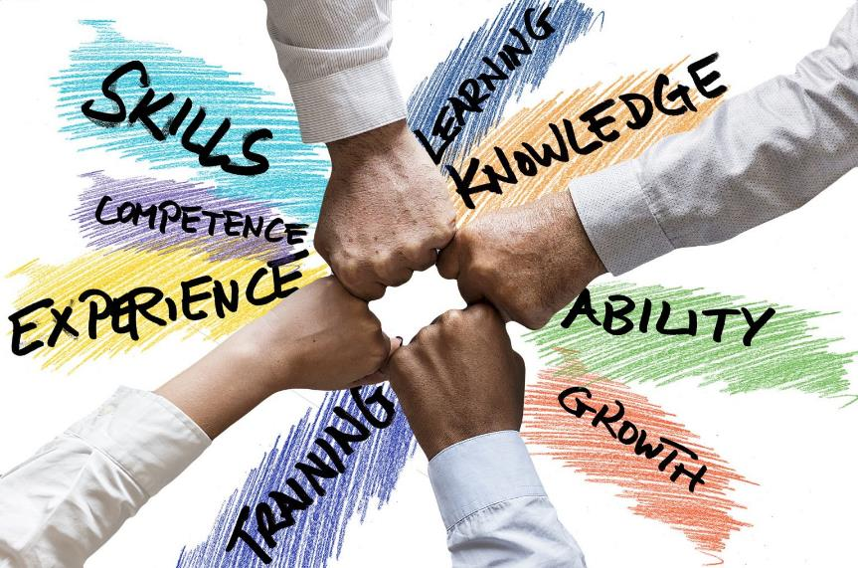
Learning 1 | Relevance for Shell
Shell fosters a professional environment by emphasizing clear communication , ownership, and maintaining a polished personal appearance while taking health and safety seriously.
By cultivating professionalism and grooming standards, Shell enhances its global reputation, builds trust with stakeholders, and improves internal collaboration while ensuring a strong commitment to safety.
This Photo by Unknown Author is licensed under CC BY-SA

Slide 9
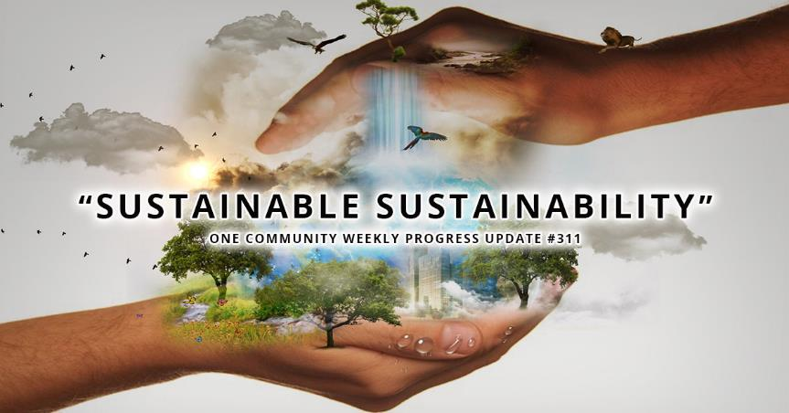
Learning 2 | Relevance for Shell
Shell uses the Power Interest Grid to manage stakeholders effectively and promotes teamwork by encouraging cross-functional collaboration and alignment with sustainability goals.
Effective stakeholder management and teamwork enhance project success, drive sustainability initiatives, and ensure that Shell meets stakeholder expectations while fostering a cohesive work environment.

Slide 10
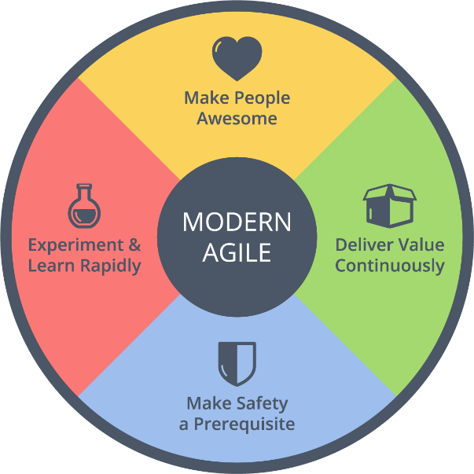
Learning 3 | Relevance for Shell
Shell employs Agile methodologies to adapt quickly to market changes and uses Business Analytics to drive data-informed decisions and optimize operation.
Agile practices enhance flexibility and responsiveness, while Business Analytics improves decision-making and operational efficiency, supporting Shell’s innovation and sustainability goals.
This Photo by Unknown Author is licensed under CC BY-SA

Slide 11

Challenges in implementing learning

Slide 12
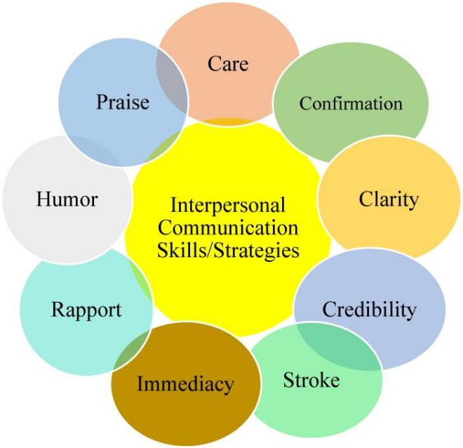
Challenge faced while implementing Learning 1
Challenges: Maintaining consistent professional communication and appearance amidst a busy schedule and varying workplace environment.
How to Overcome: Develop routines for regular grooming and set aside time for crafting thoughtful emails, while leveraging tools and reminders to stay organized and adhere to professional standards.

Slide 13
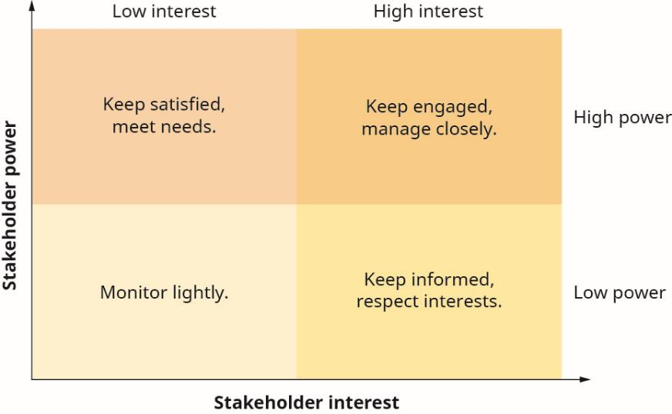
Challenge faced while implementing Learning 2
Challenges: Balancing diverse stakeholder expectations and coordinating effectively across multiple teams.
How to Overcome: Use structured stakeholder management techniques like Power Interest Grid and establish clear communication channels to align team efforts and address stakeholder needs.

Slide 14
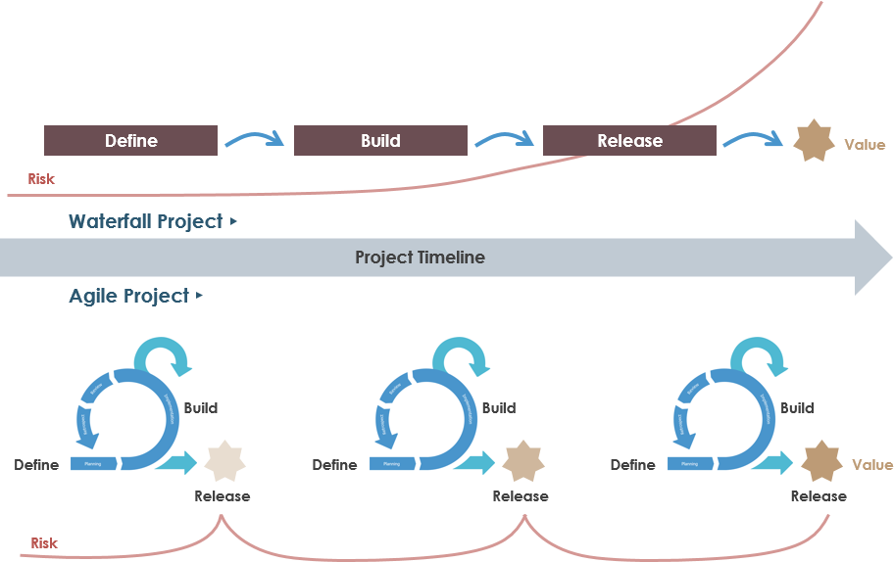
Challenge faced while implementing Learning 3
Challenges: Adapting to the iterative nature of Agile and integrating data-driven insights into decision-making processes.
How to Overcome: Embrace Agile practices through regular training and iterative feedback and enhance data literacy by leveraging analytical tools and collaborating with data experts.

Slide 15

Action Plan

Slide 16
My Action Plan for this Week
Actions
Timeline
Status
Connecting with fellow Freshers and Team Members
Explore Organizational Culture
Engage in Informal Conversations
Day 1: Reach out to fellow freshers
Day 2&3: Gather insights about their experiences.
Day 4: Attend team meeting.
Day 5: Reflect on observations.
Connected with individuals from different batches and my team.
Actively participated in training sessions.

Slide 17

Learning is also Fun!

Slide 18
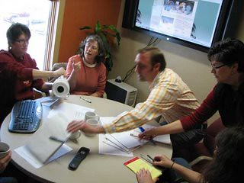
Learning is also Fun!
The sessions were made enjoyable through various new activities, with teams shuffled for each exercise to encourage meeting new people.
We participated in a role play exercise to demonstrate professional behavior, Each group aced out a meeting, highlighting unprofessional behaviors in a humorous way.
The role play led to amusing skits, with each group creatively showcasing their points, resulting in lots of laughter and a memorable learning experience.

Slide 19

Summary
The first three days of training covered essential soft skills for corporate settings, such as effective interjection, constructive criticism and polite elaboration requests, along with technical skills like DevOps on Microsoft Azure and managing project elements in the Azure cloud.
The skills learned this week will enhance our ability to communicate effectively with facilitators, ensuring a clearer and more comprehensive understanding of the subjects being taught.
The soft skills and technical knowledge gained are interlinked, as effective communication and collaboration will support the application of technical skills like DevOps and project management in real-world scenarios.

Slide 20
Thank You

